Slide 1

Detecting Spam Emails
Student Details
Name:
N.GOKUL RAJ
NM Id:
au61772111027
College Name: GOVERNMENT COLLEGE OF ENGINEERING, SALEM-11

Slide 2

Detecting Spam Emails
Disclaimer
The content is curated from online/offline resources and used for educational
purpose only

Slide 3

Detecting Spam Emails
Course Outline
•
•
•
•
•
•
•
•
•
Abstract
Problem Statement
Aims, Objective & Proposed System/Solution
System Deployment Approach
Model Development & Algorithm
Future Scope
Video of the Project
Conclusion
Reference

Slide 4

Detecting Spam Emails
Abstract
Email spam continues to be a pervasive
issue, causing inconvenience and
potential harm to users. In this project, we
propose a machine learning approach to
automatically detect spam emails. The
project involves collecting a dataset of
labeled emails, where each email is
classified as spam or non-spam (ham).
The project aims to develop a robust and
efficient spam detection system that can
be deployed to protect users from
unwanted and potentially harmful emails.

Slide 5

Detecting Spam Emails
Problem Statement
• Detecting Spam Emails Using TensorFlow.
Implement and build a deep-learning
model for Spam Detection. The model we
will try to implement will be a Classifier,
which would give binary outputs- either
spam or ham.

Slide 6

Detecting Spam Emails
Aim and Objective
Aim: This project aims to develop an effective spam email detection system using
machine learning techniques. The project will involve collecting a dataset of
labeled emails, preprocessing the email text data, extracting relevant features, and
training a machine learning model to classify emails as spam or non-spam (ham).

Slide 7
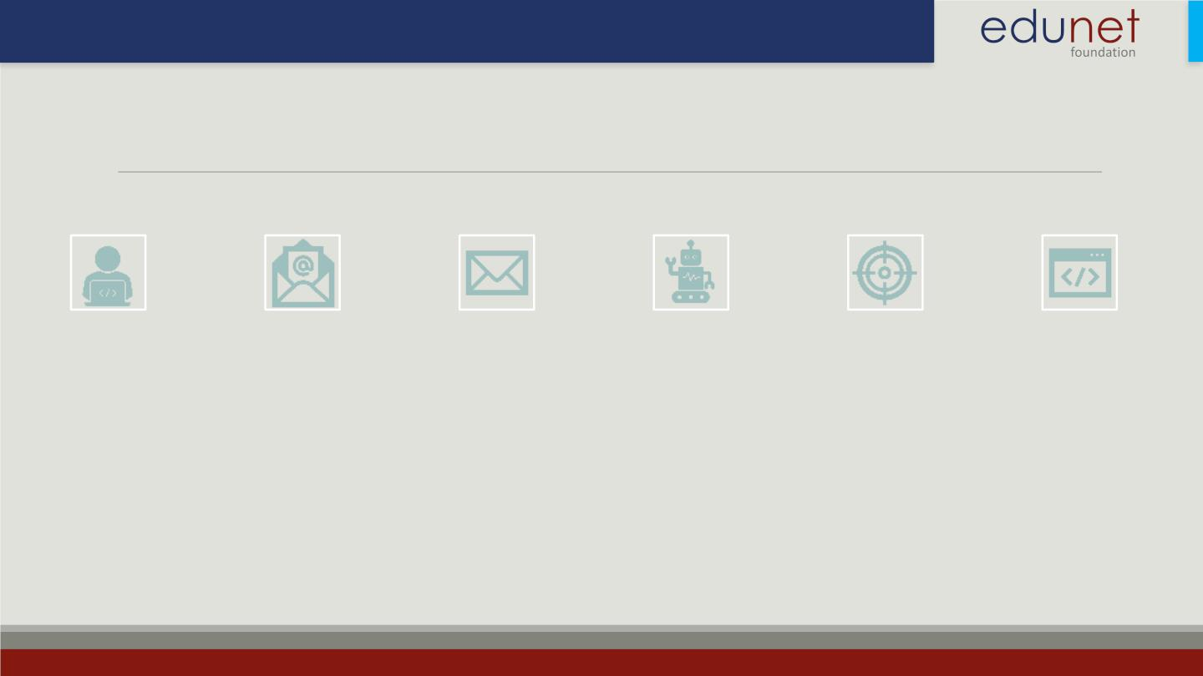
Detecting Spam Emails
Objectives
Collect a dataset of
labeled emails,
including spam and
non-spam (ham)
emails.
Preprocess the email
Extract relevant
features from the
email text data using
techniques such as TF
-IDF and N-grams.
Train a machine
learning model, such
as a Naive Bayes
classifier or a Support
Vector Machine
Evaluate the
Develop a user-
friendly interface for
the spam detection
system, allowing
users to easily classify
emails as spam or
non-spam.
text data to prepare
it for machine
learning model
training.
performance of the
trained model using
metrics such as
accuracy, precision,
recall, and F1 score..
(SVM), using the
extracted features.

Slide 8
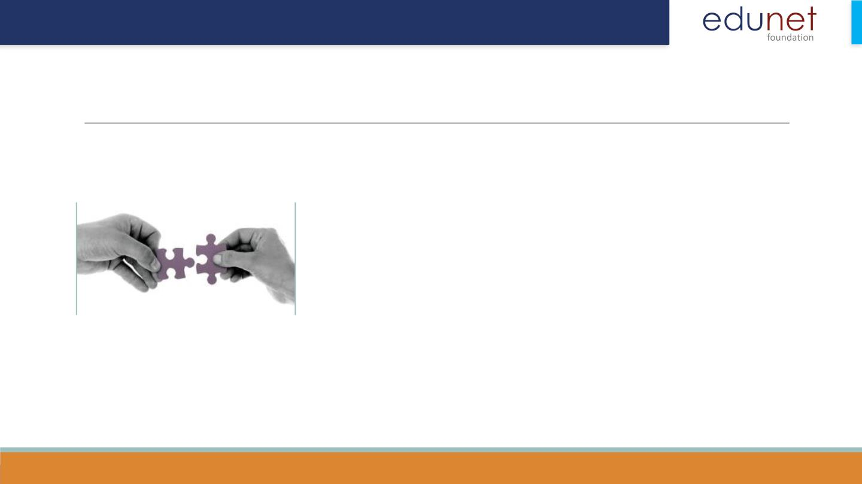
Detecting Spam Emails
Proposed Solution
• Solution: Gather a dataset of labeled emails, where each email is
labeled as spam or non-spam (ham). Preprocess the text data to
convert it into a format suitable for machine learning models.
This may include removing stop words, tokenization, and
converting text to numerical representations. Extract features
from the preprocessed text data. Common features include word
frequency, TF-IDF (Term Frequency-Inverse Document
Frequency), and N-grams. Choose a machine-learning model for
spam detection. Common models include logistic regression,
support vector machines (SVM), and naive Bayes classifiers.

Slide 9
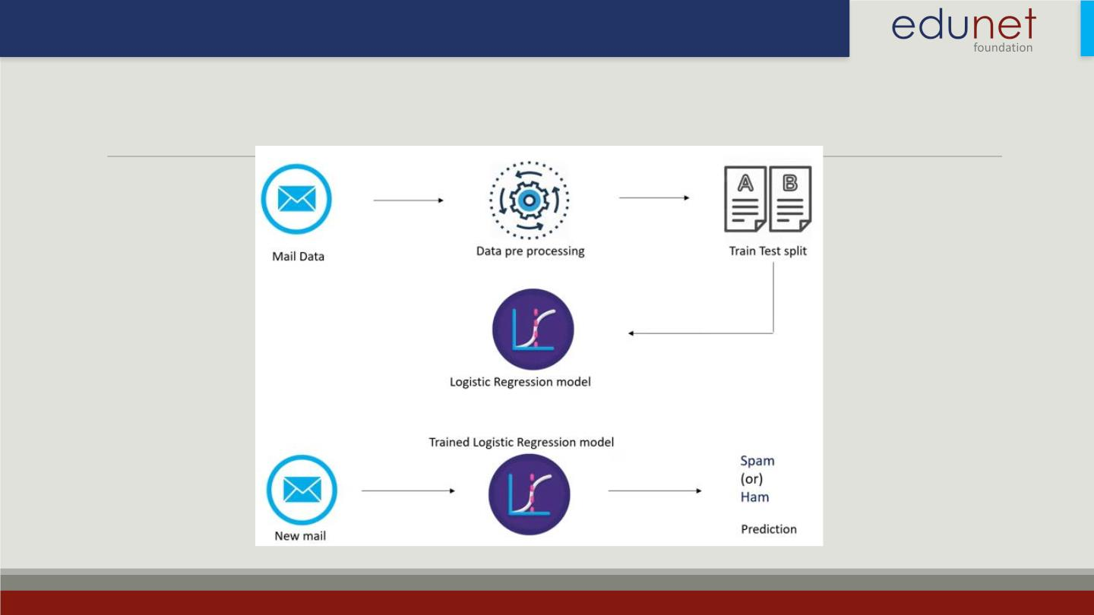
Detecting Spam Emails
System Deployment Approach

Slide 10
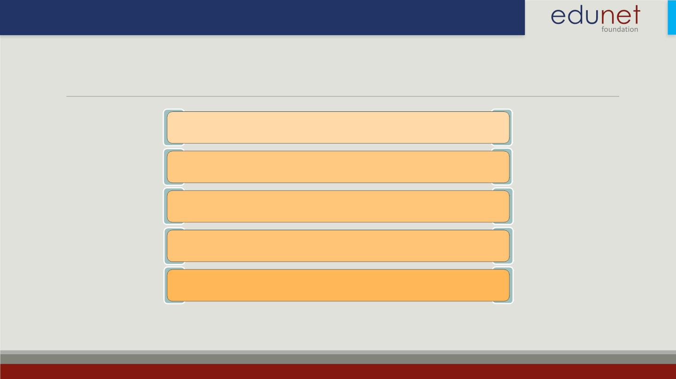
Detecting Spam Emails
Model Development & Algorithm
Dataset Description:
The dataset contains set of Emails.
Size of dataset is 5572 rows
Categorized into two classes
Spam, Ham
Each class has around 2780 sentences

Slide 11
Detecting Spam Emails
Model Development & Algorithm
Algorithm:
1.Input: Email text data
2.Output: Spam or non-spam (ham) classification
Algorithm Steps:
•Preprocess the email text data (e.g., remove stop words, tokenize).
•Extract features from the pre-processed text data (e.g., TF-IDF, N-grams).
•Train a machine learning model on the extracted features (e.g., logistic regression, SVM,
naive Bayes).
•Evaluate the trained model on a test dataset using metrics such as accuracy, precision,
recall, and F1 score.
•Fine-tune the model by experimenting with different preprocessing techniques, feature
extraction methods, and model parameters to improve performance.
•Deploy the trained model as a spam detection system for real-world use.

Slide 12
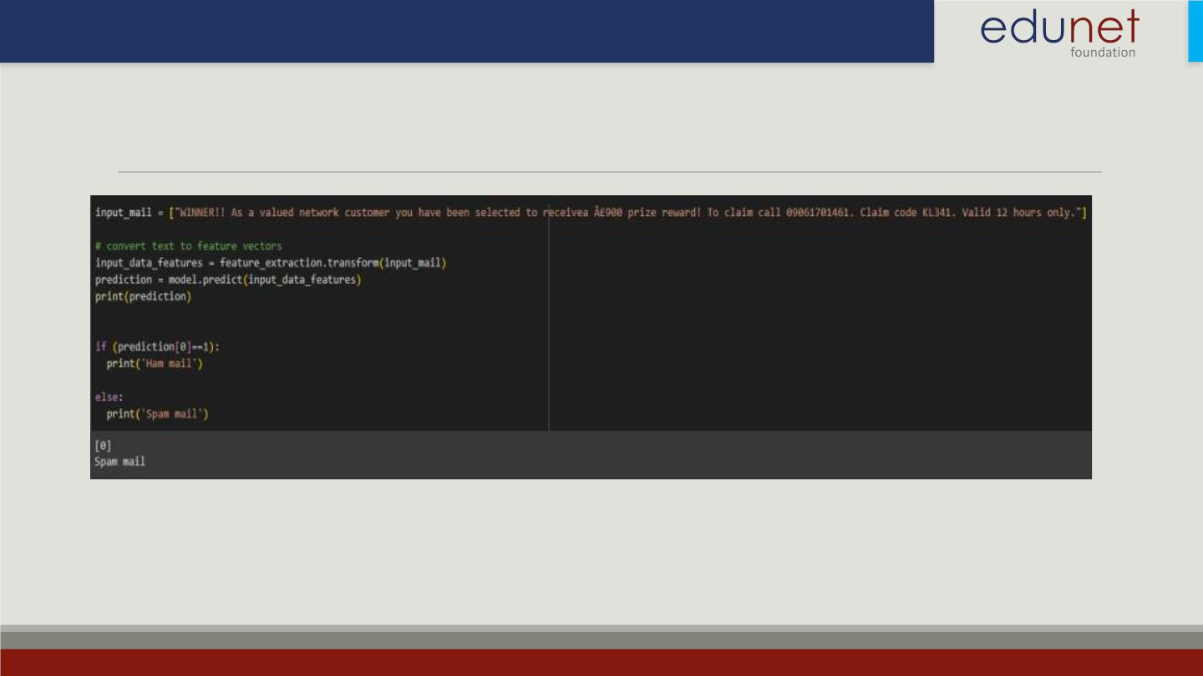
Detecting Spam Emails
Result

Slide 13
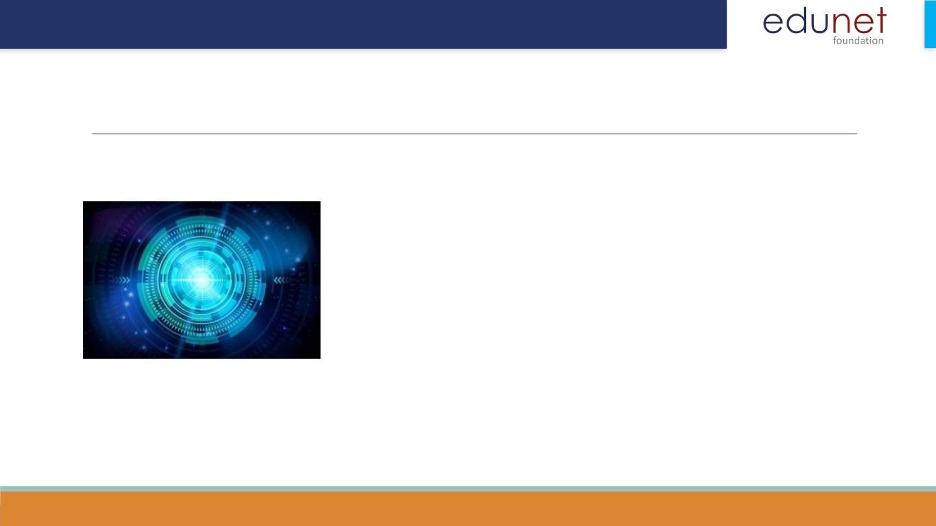
Detecting Spam Emails
Future Scope
1.Advanced Machine Learning Techniques: Explore advanced
machine learning techniques such as deep learning, ensemble
methods, and natural language processing (NLP) to improve the
accuracy and efficiency of spam email detection.
2.Real-Time Detection: Develop real-time spam detection systems
that can quickly identify and filter out spam emails as they are
received, providing users with immediate protection.
3.User Feedback Integration: Incorporate user feedback into the
spam detection system to continuously improve its performance
and adapt to new spamming techniques.
4.Multimodal Detection: Combine text-based features with other
modalities such as images and metadata to improve the detection
of sophisticated spam emails.

Slide 14
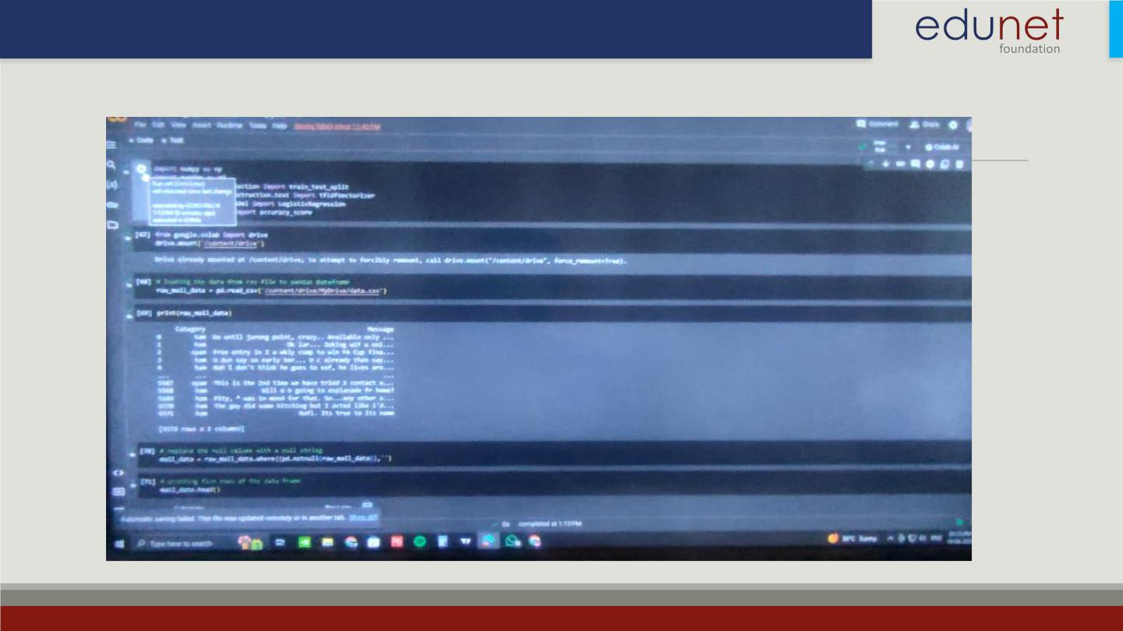
Detecting Spam Emails
Video of the Project

Slide 15
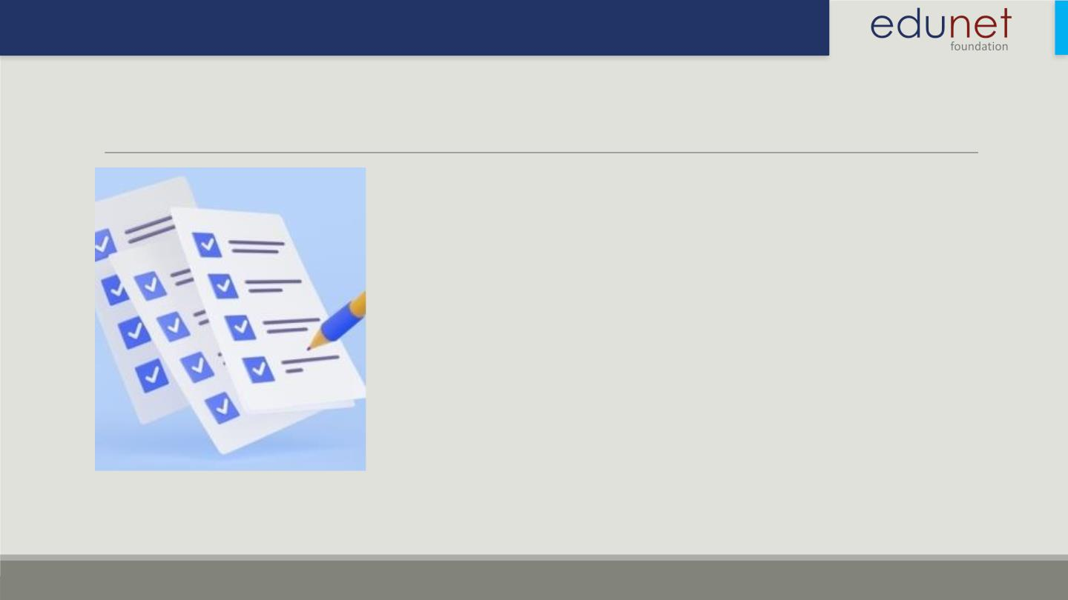
Detecting Spam Emails
Conclusion
• In conclusion, our project on spam email detection using
machine learning techniques has shown promising results in
automatically identifying and filtering out unwanted emails. By
leveraging machine learning models such as logistic regression,
support vector machines (SVM), and naive Bayes classifiers, we
could effectively classify emails as spam or non-spam (ham).
• Moving forward, there is potential to enhance this system by
exploring advanced machine learning techniques, implementing
real-time detection, and incorporating user feedback. These
improvements could further enhance the accuracy and efficiency
of spam email detection systems, ultimately improving user
experience and security.

Slide 16
Detecting Spam Emails
Reference
• https://www.coursera.org/
• https://www.udacity.com/
• https://www.kaggle.com/learn
• https://codelabs.developers.google.com/

Slide 17

Thank you!

